Slide 1
IOT 4117: IoT Architecture and Technologies
Md. Habibur Rahman
Lecturer
Department of ICT, BDU

Slide 2

Chapter 20
Network Layer:
Internet Protocol
Copyright © The McGraw-Hill Companies, Inc. Permission required for reproduction or display.

Slide 3
20-3 IPv6
The network layer protocol in the TCP/IP protocol suite is currently IPv4. Although IPv4 is well designed, data communication has evolved since the inception of IPv4 in the 1970s. IPv4 has some deficiencies that make it unsuitable for the fast-growing Internet.
Topics discussed in this section:
Deficiencies of IPv4
Advantages of IPv6
Packet Format Extension Headers

Slide 4
Deficiencies of IPv4
Despite all short-term solution the problem of address Depletion still persists in IPv4.
Demand of Real time audio and video
Fast growing Mobile IP, IP telephony, IP- capable mobile telephony services
IPv4 do not have any security measures i.e. Encryption and Authentication

Slide 5
Advantages of IPv6
Larger Address Space
128 bits address
Better Header Format
Options separated from base header and made part of data.
Improves Routing
New Options
To allow additional functionalities

Slide 6
Continued….
Allowance for extension
IPv6 is designed to handle future extensions
Support For Resource Allocation
The field “flow label” provides support for Resource allocation for special applications like real time audio and video.
Support for more Security
Encryption and authentication provides Confidentiality and Integrity.

Slide 7
Packet Format
Each Packet is composed of:
Mandatory Base Header (40 bytes)
Payload (65535 bytes)
Consists of optional extension header + data

Slide 8
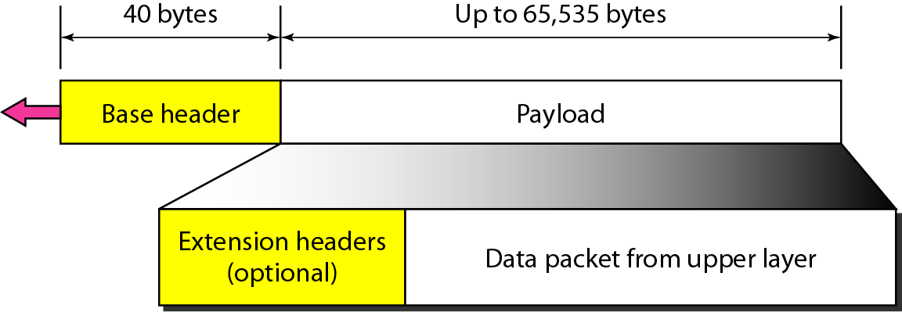
Figure 20.15 IPv6 datagram header and payload

Slide 9
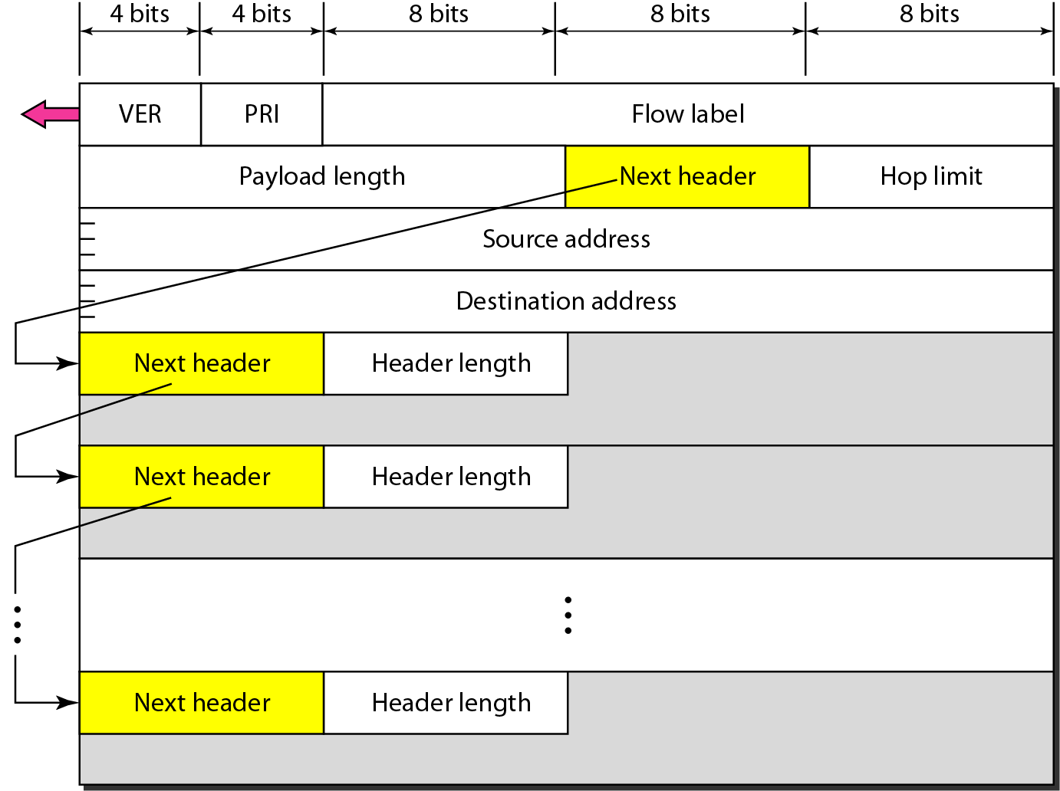
Figure 20.16 Format of an IPv6 datagram

Slide 10
Base Header
There are 8 fields:
Version
4-bit in length defines the version of IP, here value is ‘6’.
Priority
4-bit defines the priority of the packet with respect to traffic congestion.
Flow Label
24-bit designed to provide special handling for a particular flow of data.

Slide 11
Payload Length
2 byte defines the length of the payload.
Next Header
8-bit
Either optional extension header or header of another protocol e.g. TCP, UDP
Just like the protocol field in IPv4.
Hop Limit
8-bit Same as TTL field in IPv4
Source Address/ Destination Address
16 bytes both

Slide 12
Table 20.6 Next header codes for IPv6

Slide 13
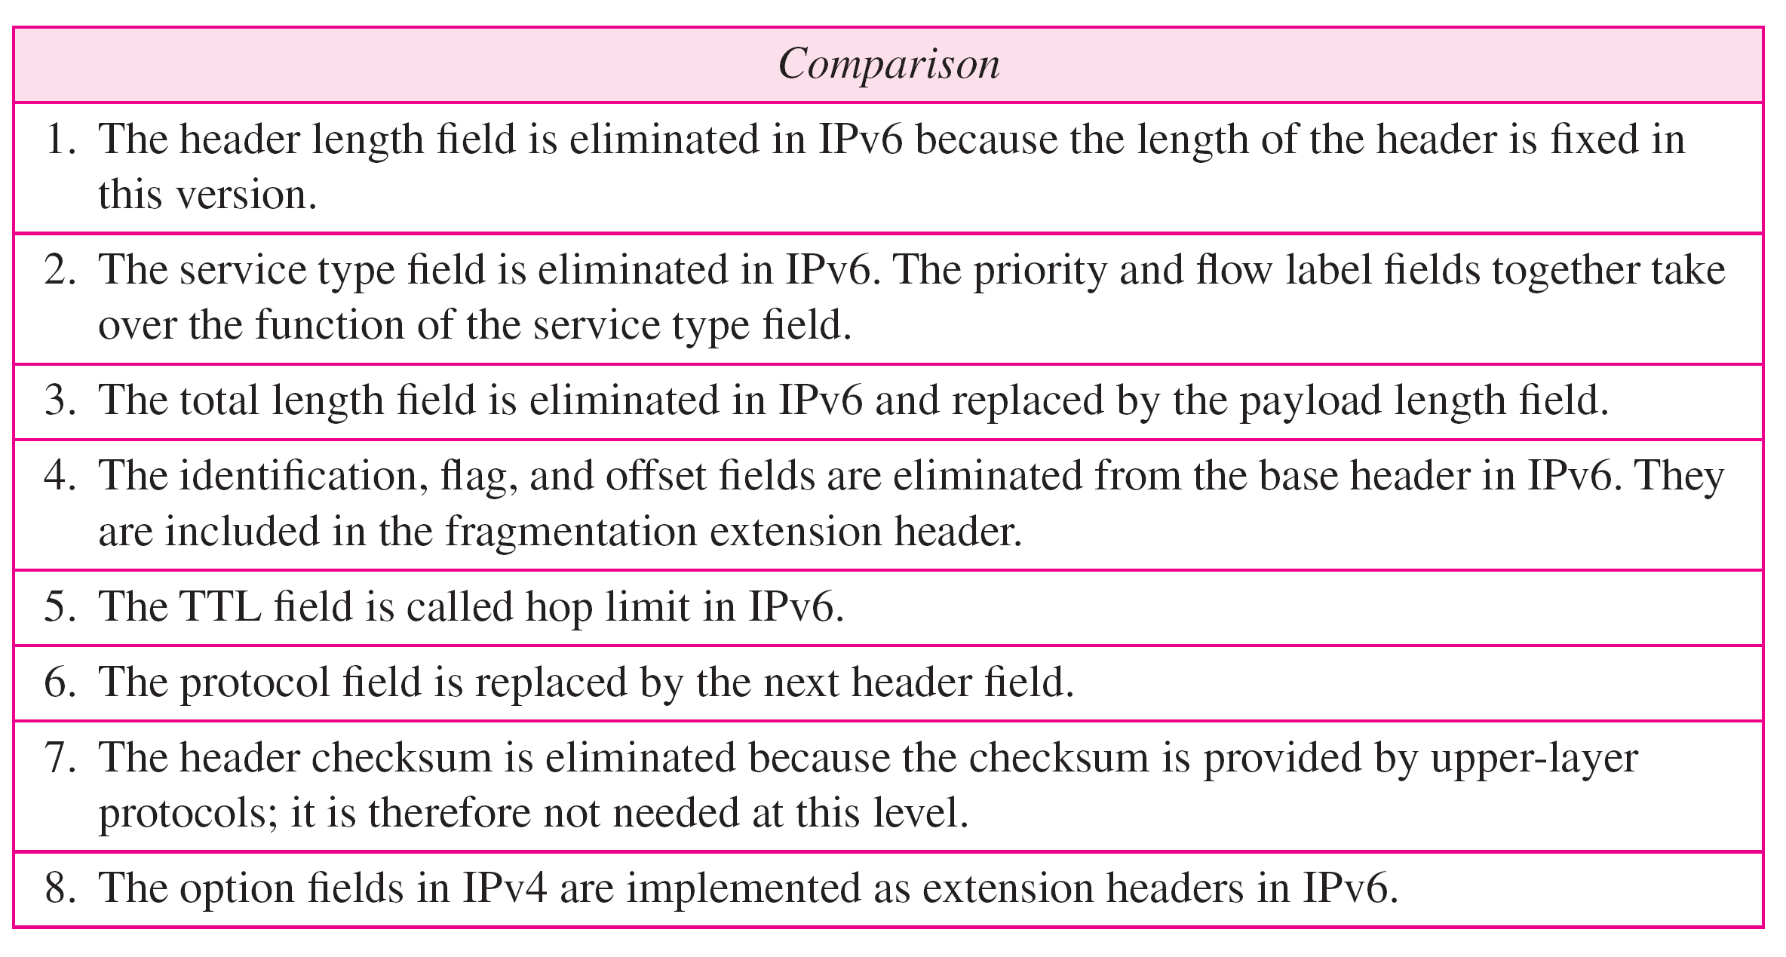
Table 20.9 Comparison between IPv4 and IPv6 packet headers

